Slide 1
Hotel Bookings

Slide 2
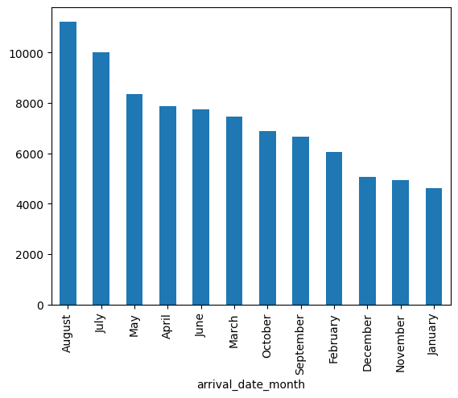
Number of Arrivals per Month

Slide 3
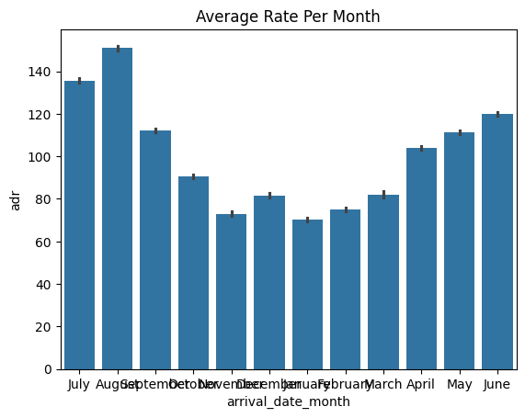
Average Daily Rate per Month

Slide 4
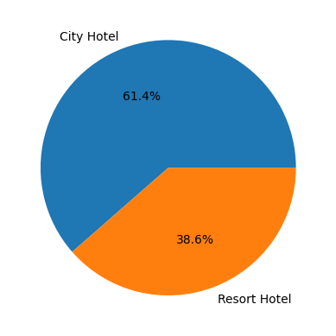
Bookings by Hotel Type

Slide 5
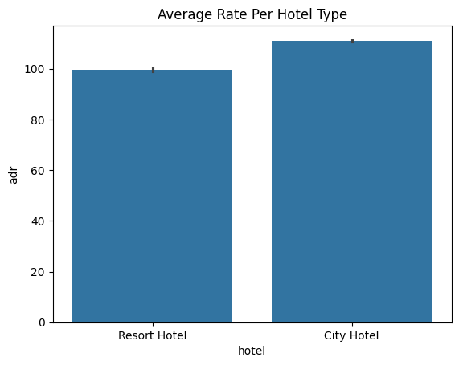
Average Rate by Hotel Type

Slide 6
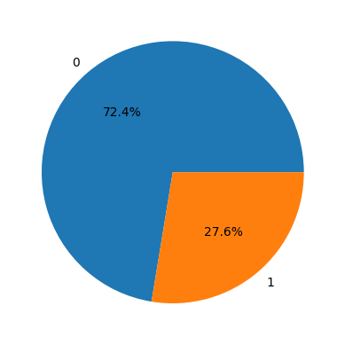
Percent of Cancellations

